Slide 1
Further abstraction techniques
Abstract classes and interfaces
7.0

Slide 2
Main concepts to be covered
Abstract classes
Interfaces
Multiple inheritance

Slide 3
Simulations
Programs regularly used to simulate real-world activities:
city traffic;
the weather;
nuclear processes;
stock market fluctuations;
environmental impacts;
space flight.

Slide 4
Simulations
They are often only partial simulations.
They often involve simplifications.
Greater detail has the potential to provide greater accuracy.
Greater detail typically requires more resource:
Processing power;
Simulation time.

Slide 5
Benefits of simulations
Support useful prediction.
E.g., the weather.
Allow experimentation.
Safer, cheaper, quicker.
Our example:
'How will the wildlife be affected if we cut a highway through the middle of this national park?'

Slide 6
Predator-prey simulations
There is often a delicate balance between species.
A lot of prey means a lot of food.
A lot of food encourages higher predator numbers.
More predators eat more prey.
Less prey means less food.
Less food means ...

Slide 7
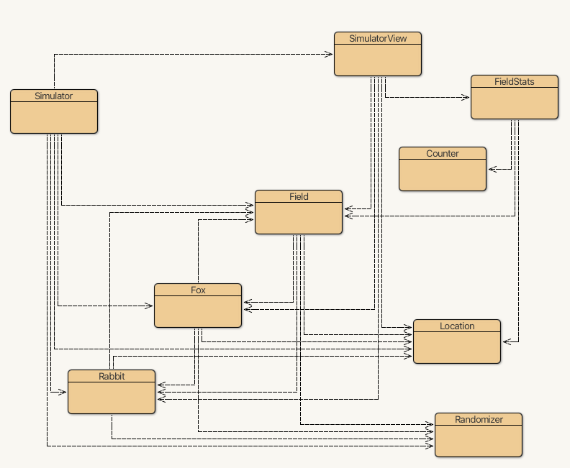
The foxes-and-rabbits project

Slide 8
Main classes of interest
Fox
Simple model of a type of predator.
Rabbit
Simple model of a type of prey.
Simulator
Manages the overall simulation task.
Holds a collection of foxes and rabbits.

Slide 9
Modeling the environment
Field
Represents a 2D field.
Location
Represents a 2D position in the environment.

Slide 10
Monitoring the simulation
SimulatorView
Presents a view of the environment.
FieldStats, Counter
Maintain statistics.
Randomizer
Supports reproducibility.

Slide 11
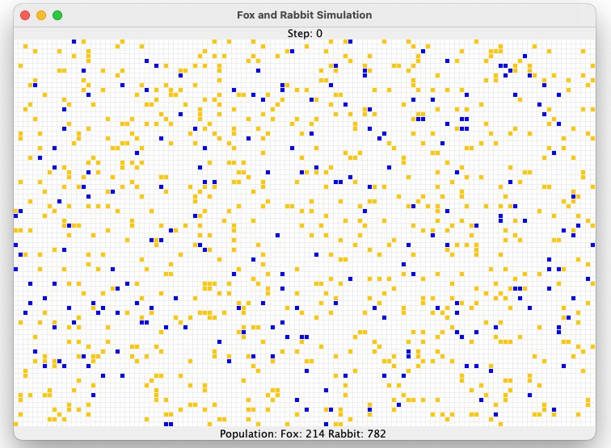
Example of the visualization

Slide 12
A Rabbit's state
public class Rabbit
{
Static fields omitted.
// Individual characteristics (instance fields).
// The rabbit's age.
private int age;
// Whether the rabbit is alive or not.
private boolean alive;
// The rabbit's position
private Location location;
Methods omitted.
}

Slide 13
A Rabbit's behavior
Managed from the run method.
Age incremented at each simulation 'step'.
A rabbit could die at this point.
Rabbits that are old enough might breed at each step.
New rabbits could be born at this point.

Slide 14
Rabbit simplifications
All rabbits can give birth.
The same rabbit could breed at every step.
All rabbits die at the same age.
Others?

Slide 15
A Fox's state
public class Fox
{
Static fields omitted
// The fox's age.
private int age;
// Whether the fox is alive or not.
private boolean alive;
// The fox's position
private Location location;
// The fox's food level, which is increased
// by eating rabbits.
private int foodLevel;
Methods omitted.
}

Slide 16
A Fox's behavior
Managed from the hunt method.
Foxes also age and breed.
They become hungry.
They hunt for food in adjacent locations.

Slide 17
Configuration of foxes
Similar simplifications to rabbits.
Hunting and eating could be modeled in different ways.
Should food level be additive?
Is a hungry fox more or less likely to hunt?
Are simplifications ever acceptable?

Slide 18
The Simulator class
Three key components:
Setup in the constructor.
The populate method.
Each animal is given a random starting age.
The simulateOneStep method.
Iterates over separate populations of foxes and rabbits.
Two Field objects are used: field and nextFieldState.

Slide 19
The update step
List<Rabbit> rabbits = field.getRabbits();
List<Fox> foxes = field.getFoxes();
// Let all the rabbits run.
for (Rabbit rabbit : rabbits) {
rabbit.run(field, nextFieldState);
}
// Let all the foxes hunt.
for (Fox fox : foxes) {
fox.hunt(field, nextFieldState);
}
// Replace the old state with the new one.
field = nextFieldState;

Slide 20
Room for improvement
Fox and Rabbit have strong similarities but do not have a common superclass.
The update step involves similar-looking code.
The Simulator is tightly coupled to specific classes.
It 'knows' a lot about the behavior of foxes and rabbits.

Slide 21
The Animal superclass
Place common fields in Animal:
alive, location
Method renaming to support information hiding:
run and hunt become act.
Simulator can now be significantly decoupled.

Slide 22
Revised (decoupled) iteration
List<Animal> animals = field.getAnimals();
for (Animal anAnimal : animals) {
anAnimal.act(field, nextFieldState);
}
// Replace the old state with the new.
field = nextFieldState;
The Simulator now has looser coupling to the subtypes of Animal.

Slide 23
The act method of Animal
Static type checking requires act in Animal.
There is no obvious shared implementation.
So: Define act as abstract.
/**
* Act.
* @param currentField The current state of the field.
* @param nextFieldState The new state being built.
*/
abstract public void act(Field currentField, Field nextFieldState);

Slide 24
Abstract classes and methods
Abstract methods have abstract in the signature.
Abstract methods have no body.
Abstract methods make the class abstract.
Abstract classes cannot be instantiated.
Concrete subclasses complete the implementation.

Slide 25
The Animal class (abstract)
public abstract class Animal
{
… instance fields and constructor omitted …
/**
* Act.
* @param currentField The current state.
* @param nextFieldState The new state being built.
*/
abstract public void act(Field currentField, Field nextFieldState);
… other methods omitted …
}

Slide 26
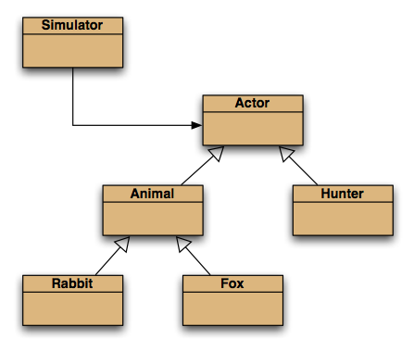
Further abstraction

Slide 27
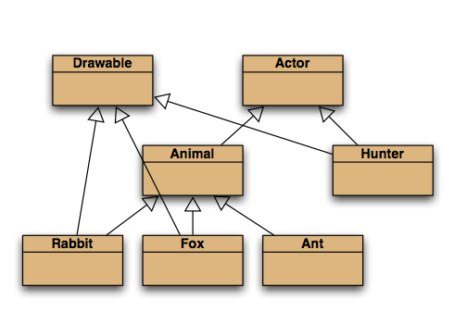
Selective drawing (multiple inheritance)

Slide 28
Multiple inheritance
Having a class inherit directly from multiple ancestors.
Each language has its own rules.
How to resolve competing definitions?
Java forbids it for classes.
Java permits it for interfaces.

Slide 29
An Actor interface
public interface Actor
{
/**
* Perform the actor's regular behavior.
* @param currentField The current state.
* @param nextFieldState The new state being built. */
void act(Field currentField, Field nextFieldState);
/**
* Is the actor still active?
* @return true if still active, false if not.
*/
boolean isActive();
}

Slide 30
Classes implement an interface
public class Fox extends Animal implements Drawable
{
...
}
public class Scientist implements Actor, Drawable
{
...
}

Slide 31
Interfaces as types
Implementing classes are subtypes of the interface type.
So, polymorphism is available with interfaces as well as classes.

Slide 32
Features of interfaces
Use interface rather than class in their declaration.
They do not define constructors.
All methods are public.
All fields are public, static and final. (Those keywords may be omitted.)
Abstract methods may omit abstract.

Slide 33
Features of interfaces
Methods marked as default have a method body – they are not abstract.
Methods marked as static have a method body.
Default and static methods could complicate multiple inheritance of interfaces.

Slide 34
Default methods
Introduced in Java 8 to adapt legacy interfaces; e.g., java.util.List.
Classes inheriting two with the same signature must override the method.
Syntax for accessing the overriden version: InterfaceType.super.method(…)

Slide 35
Interfaces as specifications
Strong separation of functionality from implementation.
Though parameter and return types are mandated.
Clients interact independently of the implementation.
But clients can choose from alternative implementations.
List, Map and Set are examples.

Slide 36
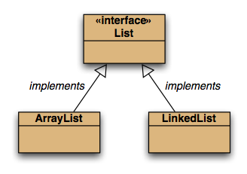
Alternative implementations

Slide 37
Functional interfaces and lambdas
Interfaces with a single abstract method are functional interfaces.
@FunctionalInterface is the associated annotation.
A lambda may be used where a functional interface is required.
java.util.function defines some functional interfaces.

Slide 38
Common functional interfaces
Consumer: for lambdas with a void return type.
BinaryOperator: for lambdas with two parameters and a matching result type.
Supplier: for lambdas returning a result.
Predicate: returns a boolean.

Slide 39
Functional interfaces
Having functional types for lambdas means we can assign them to variables, or pass them as parameters; e.g.:
BinaryOperator<String> aka = (name, alias) -> {
return name + " (AKA " + alias + ")"; };
A binary operator lambda that takes two String 'operands' and returns a String result.

Slide 40
The Class class
A Class object is returned by getClass() in Object.
The .class suffix provides a Class object: Fox.class
Used in SimulatorView: Map<Class, Color> colors;
String getName() for the class name.

Slide 41
Review
Inheritance can provide shared implementation.
Concrete and abstract classes.
Inheritance provides shared type information.
Classes and interfaces.

Slide 42
Review
Abstract methods allow static type checking without requiring implementation.
Abstract classes function as incomplete superclasses.
No instances.
Abstract classes support polymorphism.

Slide 43
Review
Interfaces provide specification – usually without implementation.
Interfaces are abstract apart from their default methods.
Interfaces support polymorphism.
Java interfaces support multiple inheritance.

